Slide 1
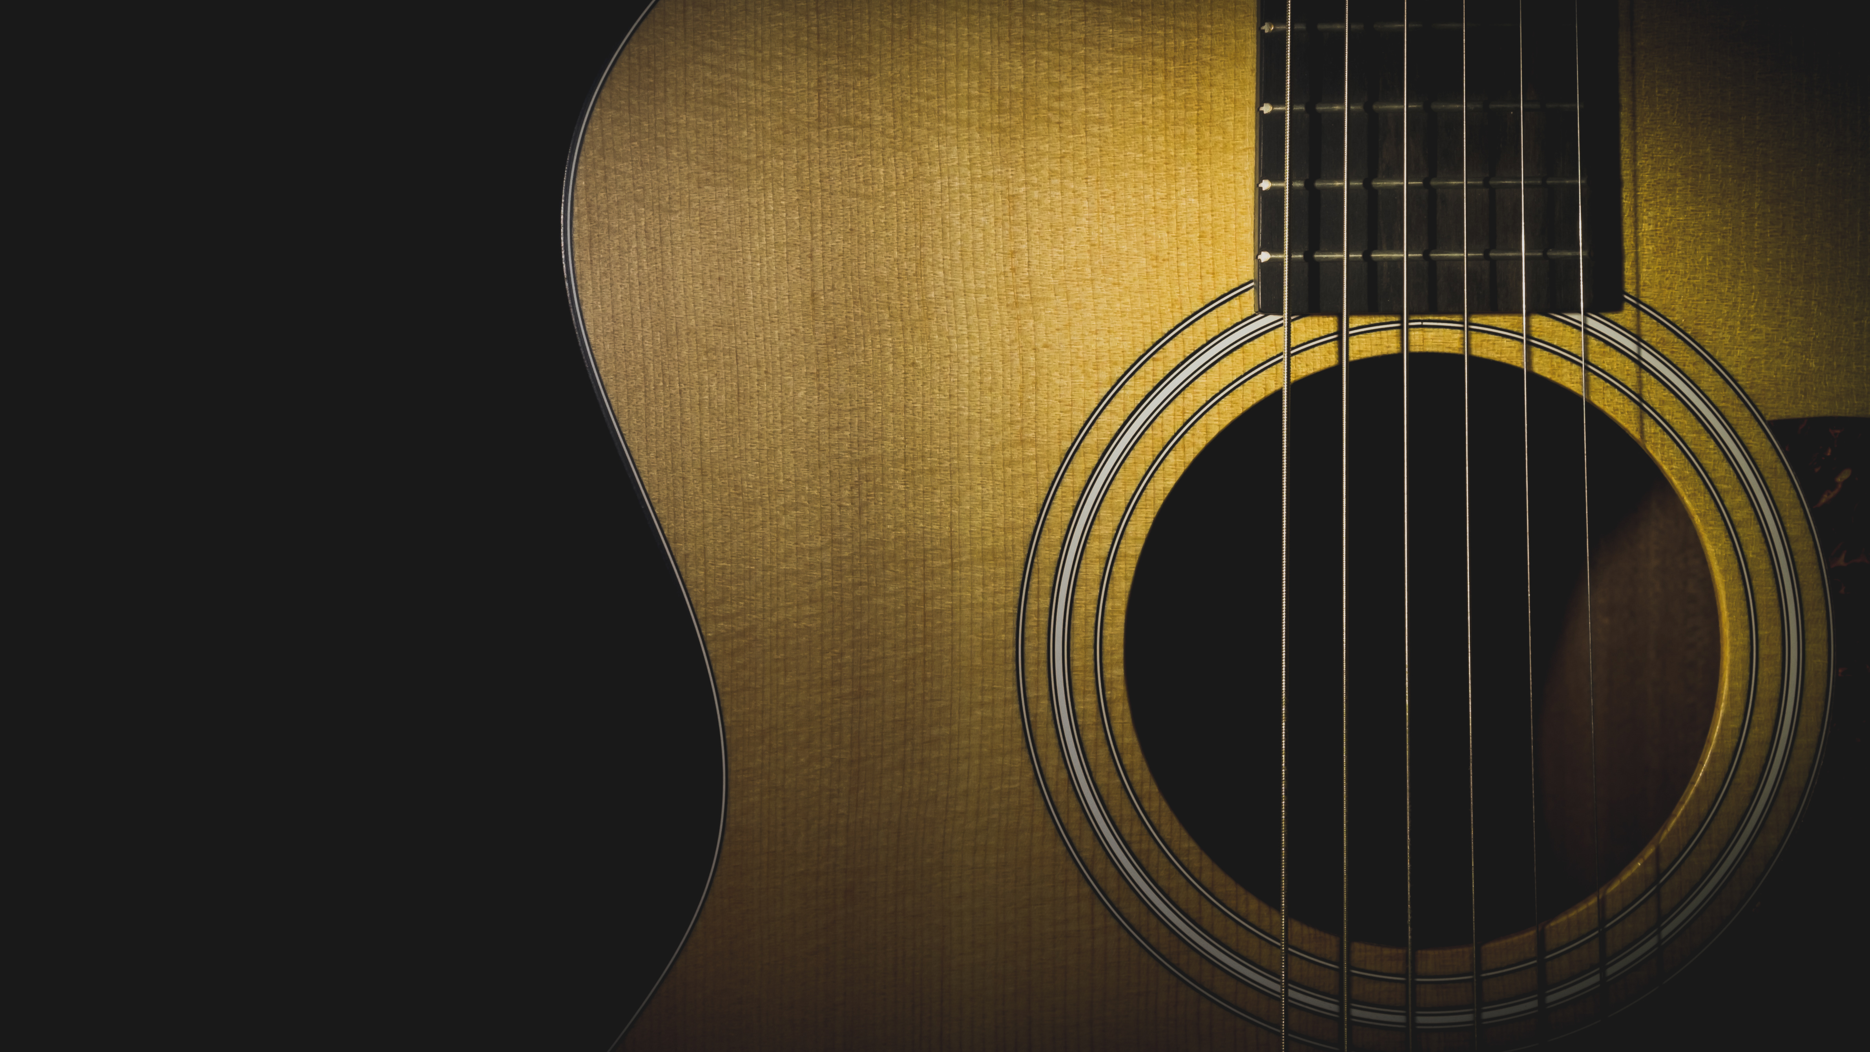
The GuitarGlove
By- Kritarth, Suhaani and Sumair

Slide 2
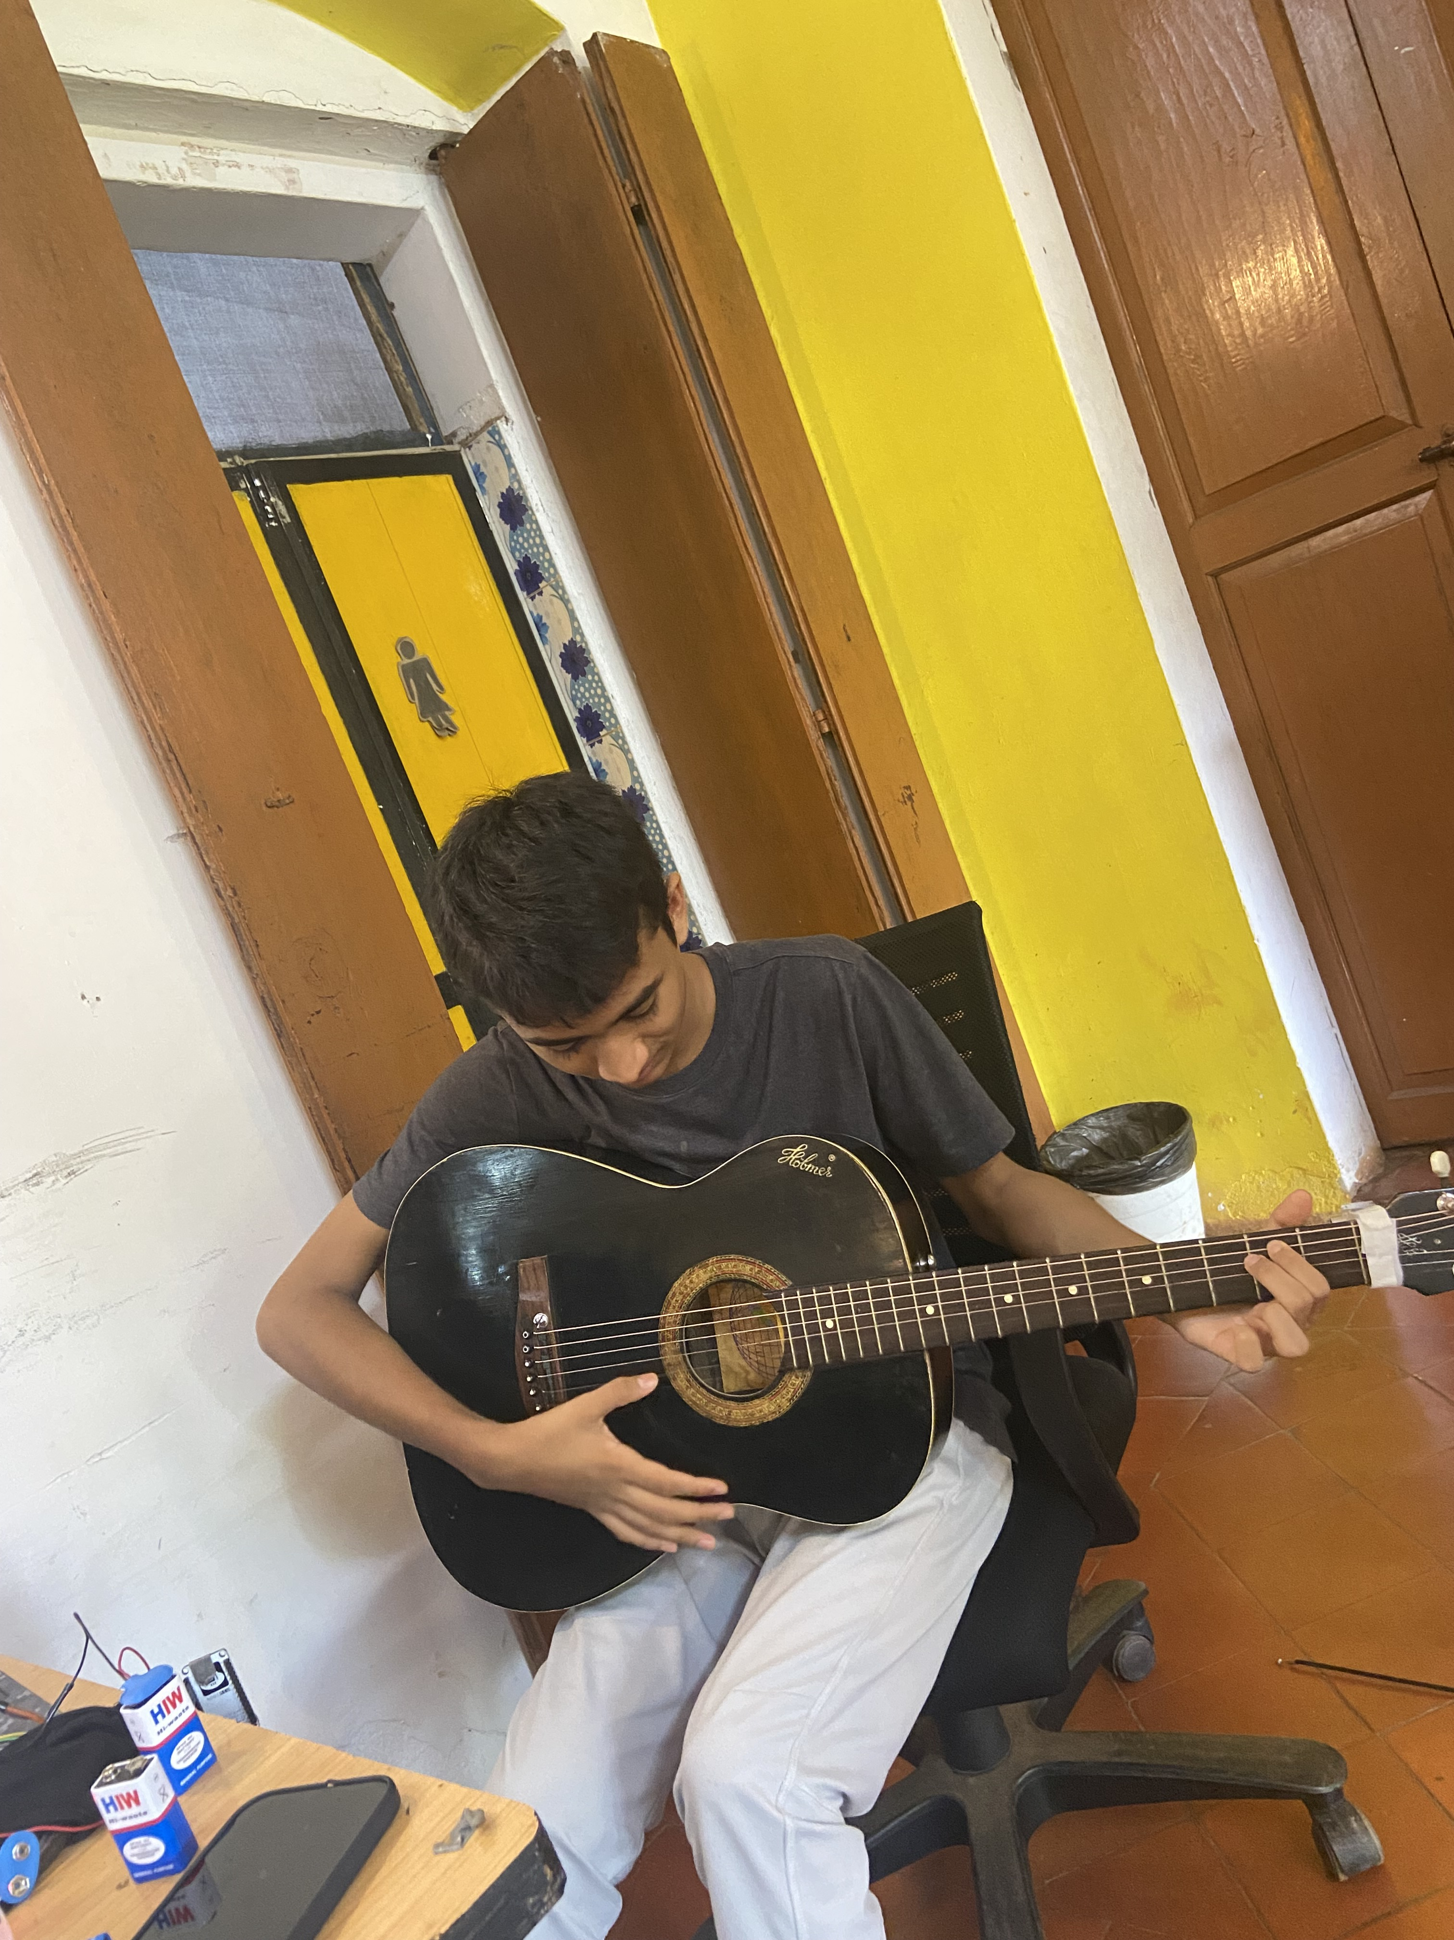
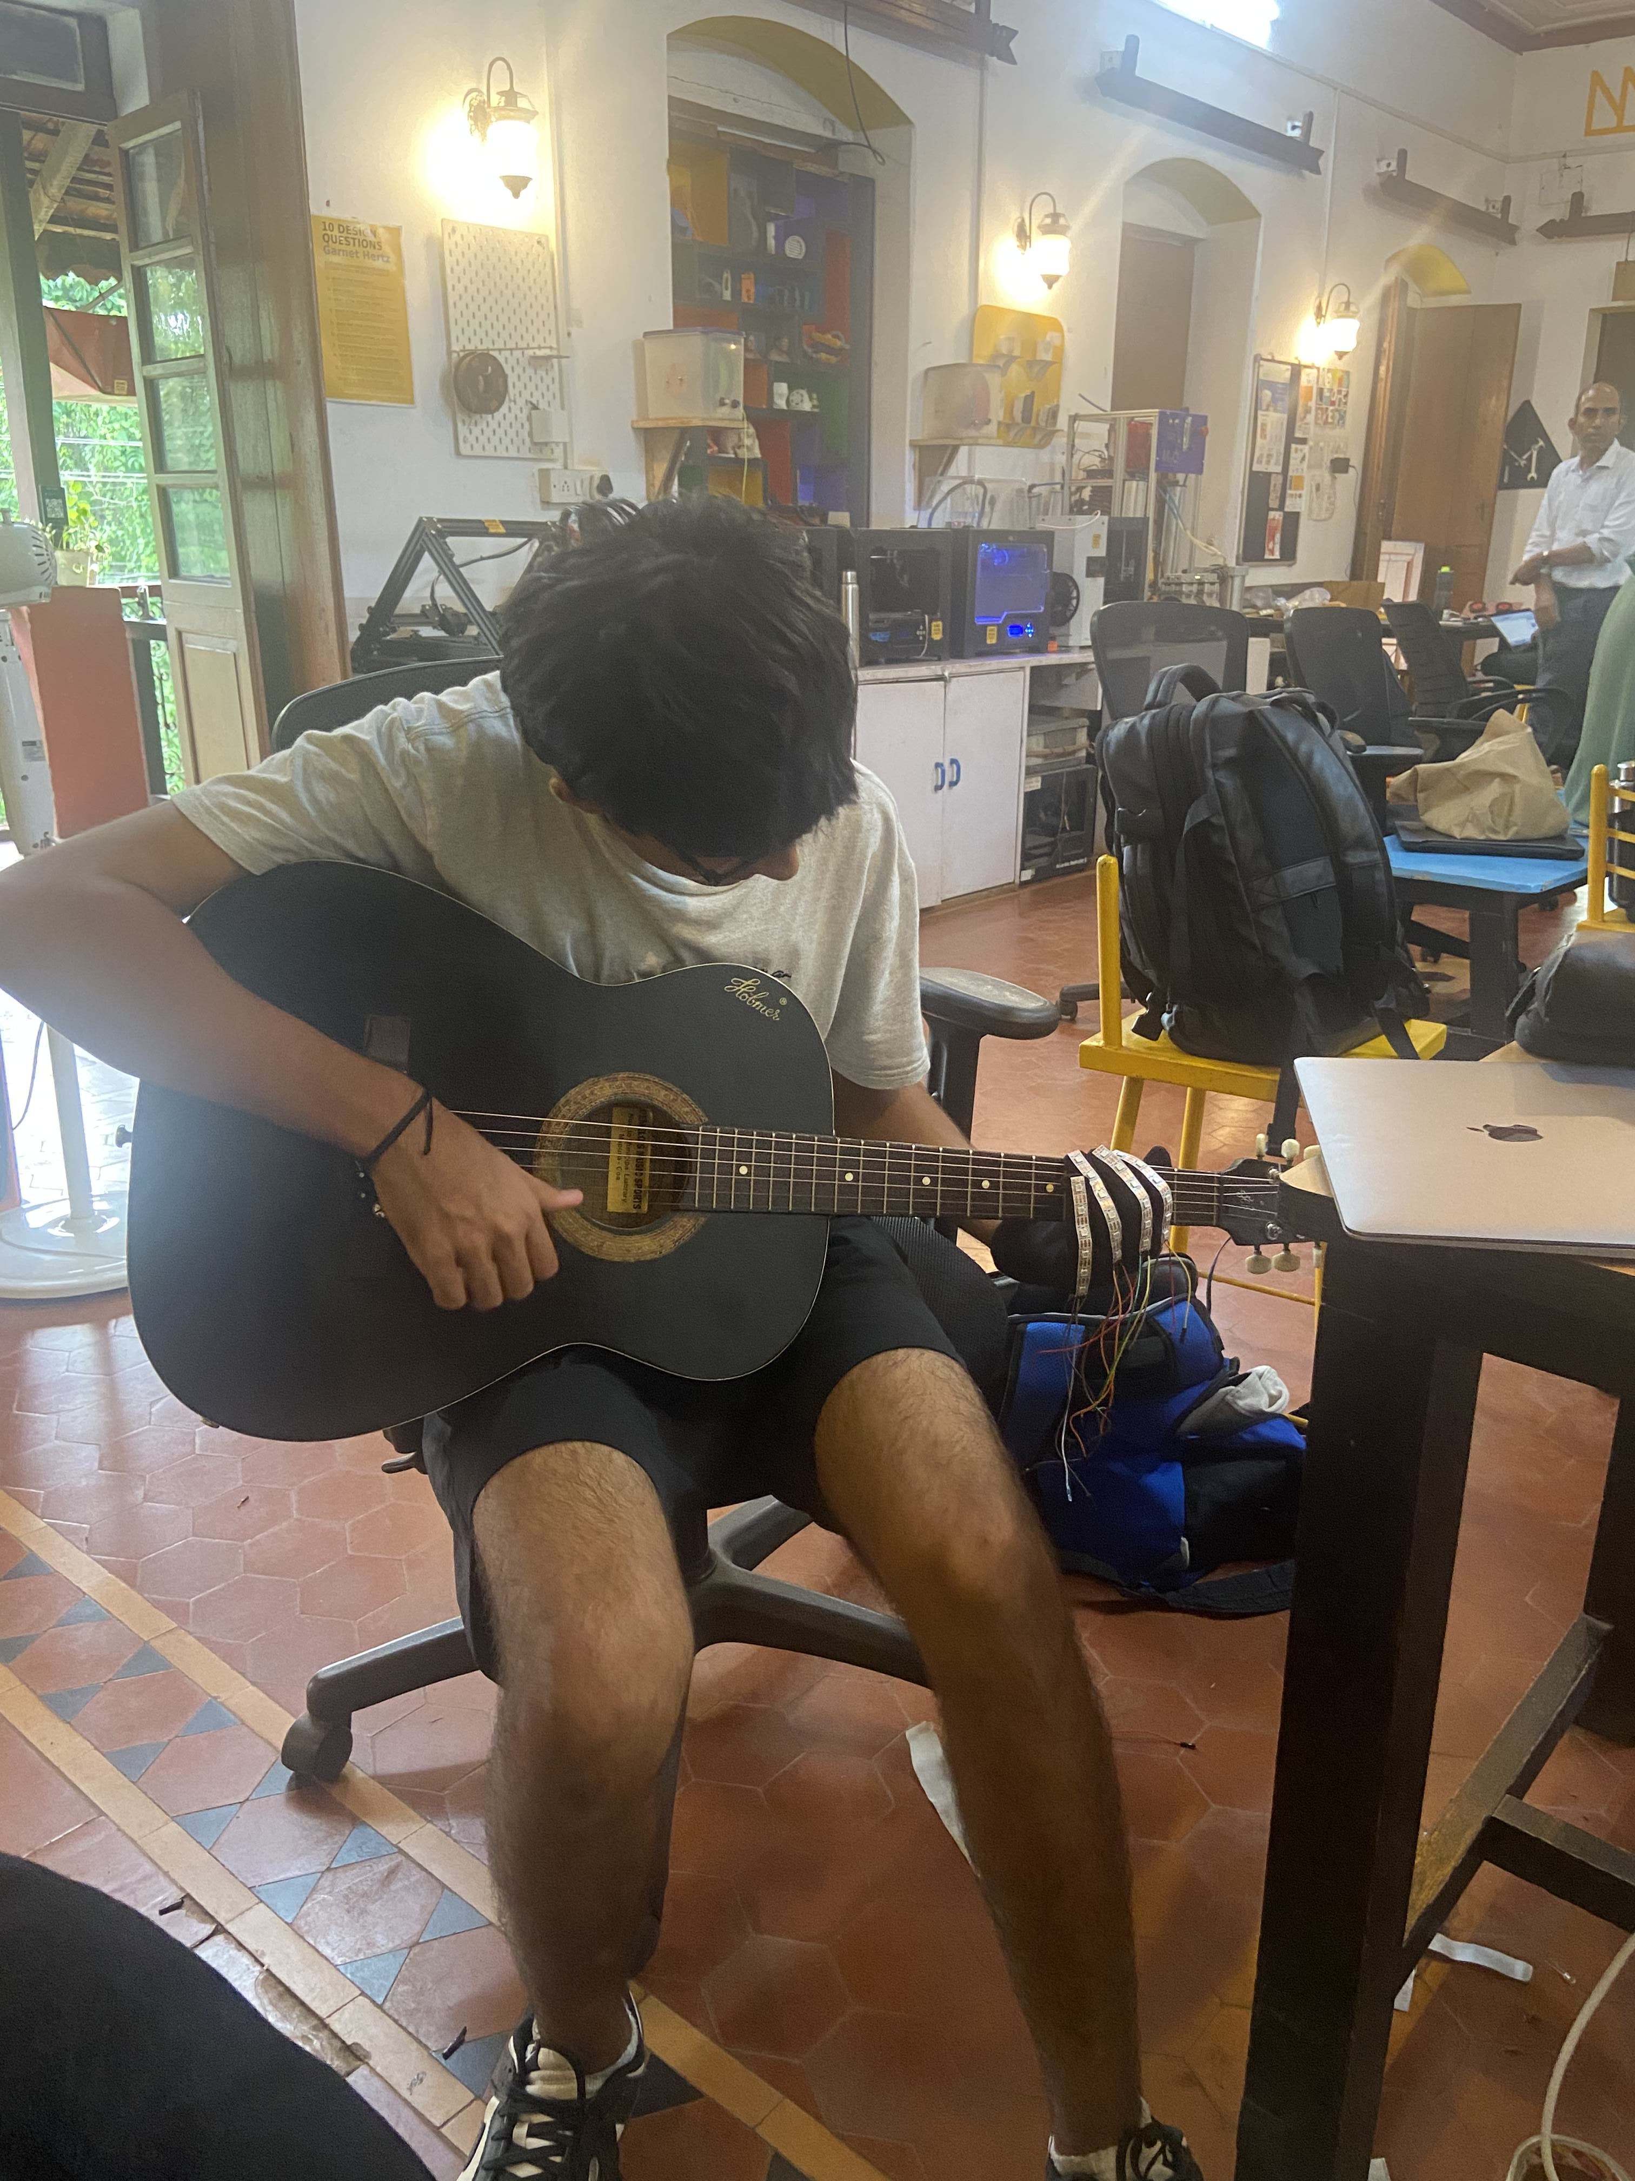
Problem statement
Learning the guitar is not easy: teachers are expensive, musical notes are hard to understand, and remembering each chord is difficult. So, we created an alternative for children while helping to make learning chords more intuitive and creating a fun experience for users

Slide 3
Idea
Our idea is to revolutionize guitar learning with an assistive smart glove. This glove provides visual and sensory guidance, making learning more accessible and enjoyable By addressing the high cost of lessons and the difficulty of remembering chords, we create an intuitive and engaging learning experience.

Slide 4
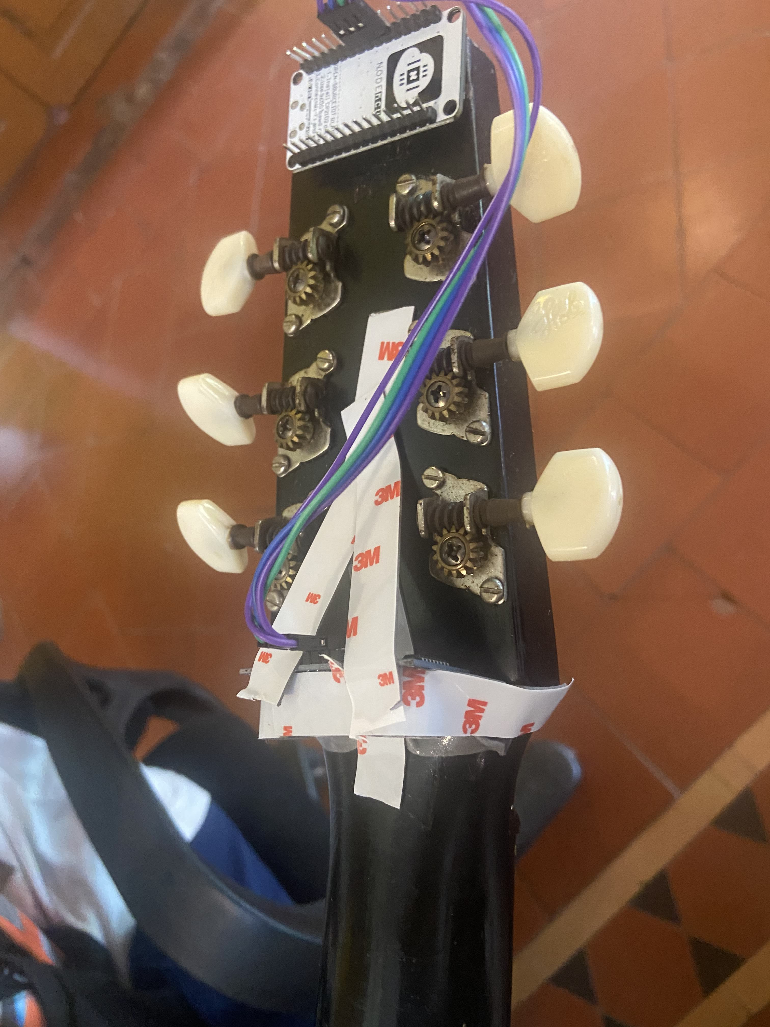
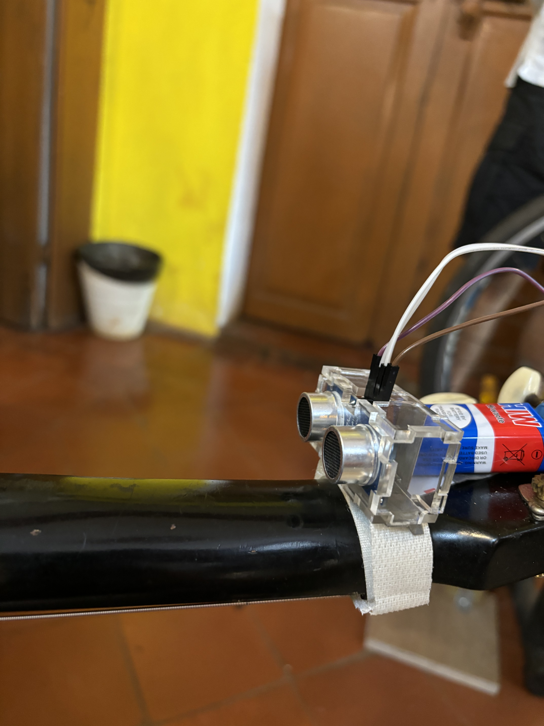
Our solution
Each finger of the glove will have 6 LEDs representing the 6 strings of the guitar. These LEDs will light up to indicate where each finger should be placed on the strings.
The glove will also have sensors to detect the hand's position and will only light up the LEDs when the hand is in the correct position to play the chord (correct fret ).
This glove will connect to a guitar learning website, allowing the user to choose the chord they want to play and making learning guitar more intuitive and engaging.

Slide 5
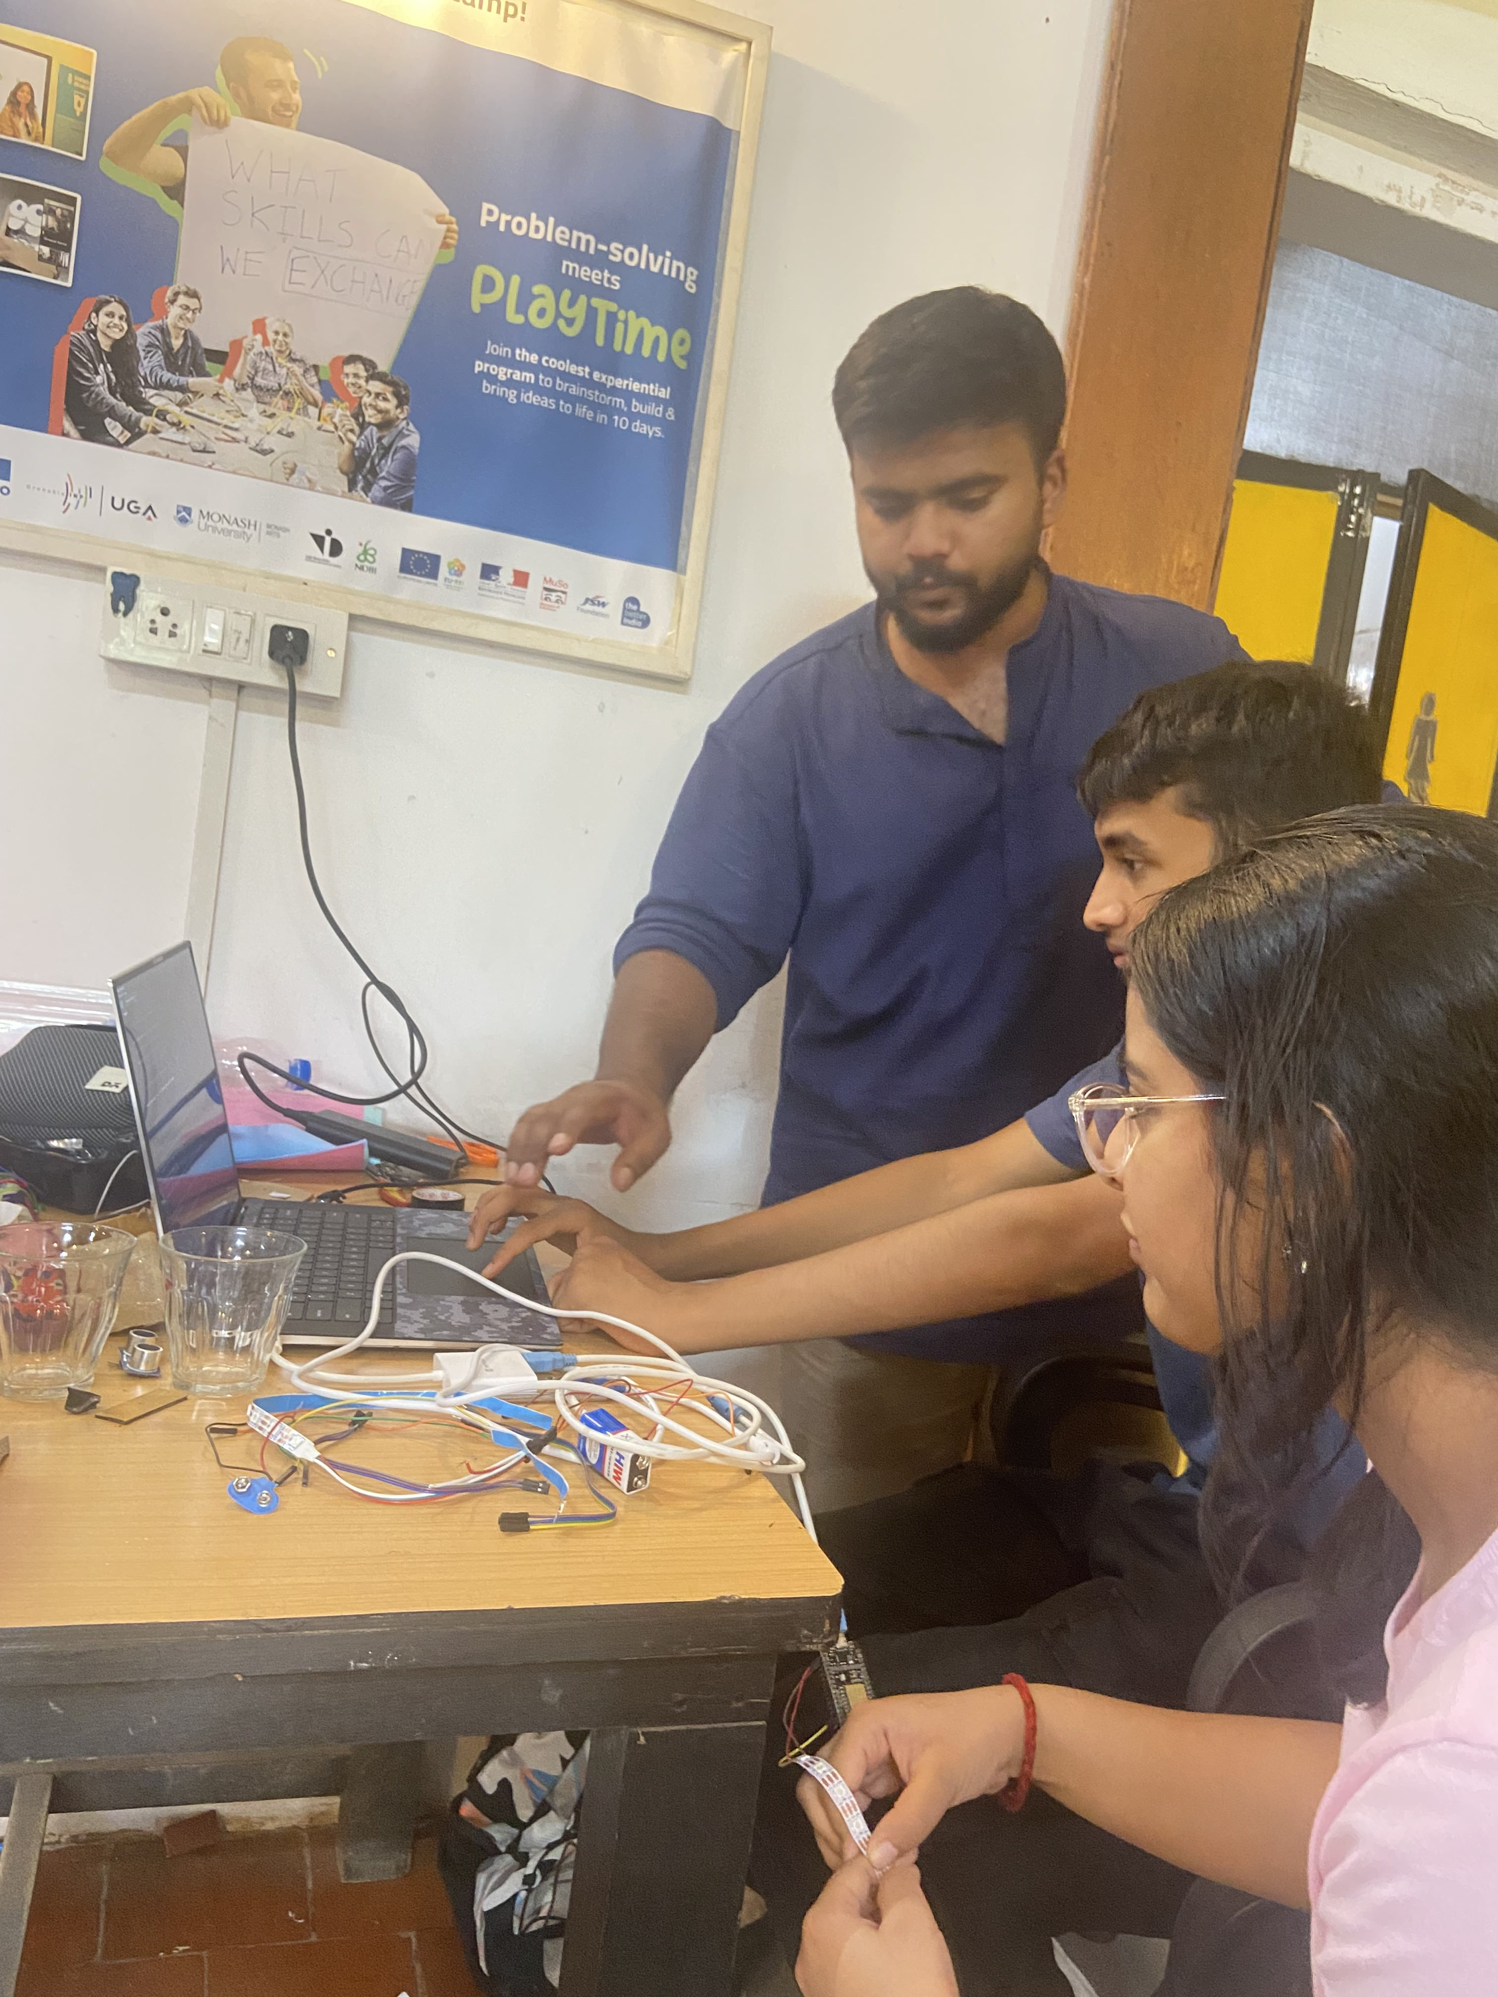
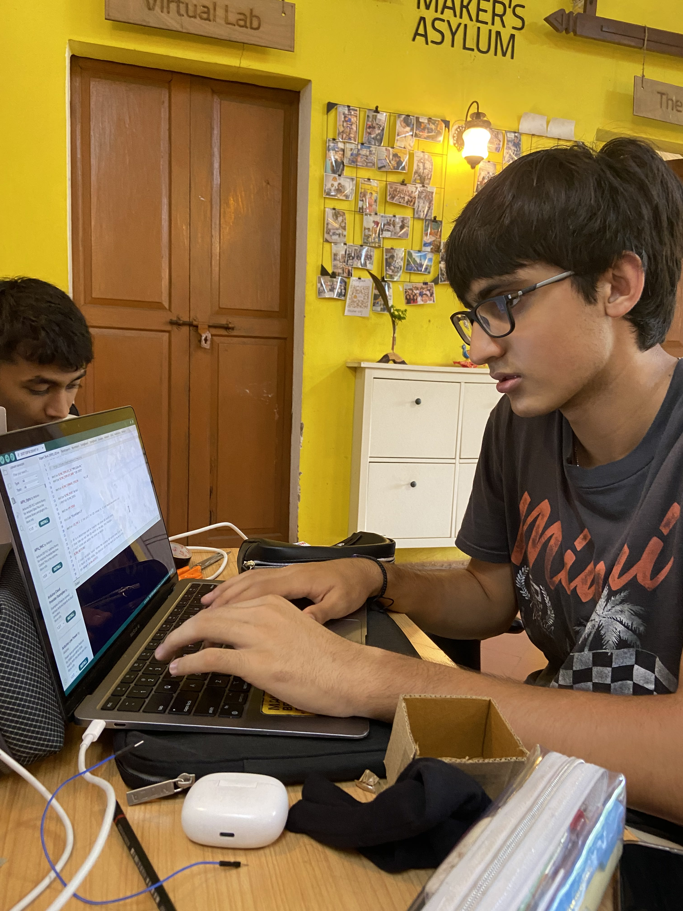
Thank You!

